Slide 1
Training on JavaScript Revealing module pattern and intro to Jasmine testing framework

Slide 2
Agenda
What is Revealing module pattern?
What is Jasmine framework for JavaScript testing?
How both of the above integrated in EOL

Slide 3
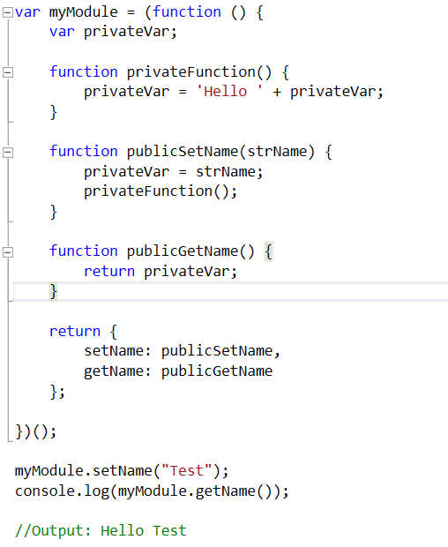
Revealing module pattern

Slide 4
Check the App

Slide 5
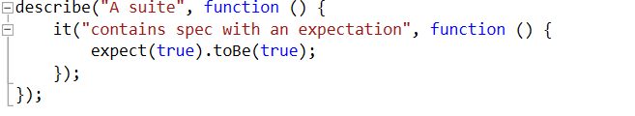
Jasmine Framework
Basic structure
describe -> Test suite
it -> Spec
expect -> Expectations
toBe() -> Matcher

Slide 6
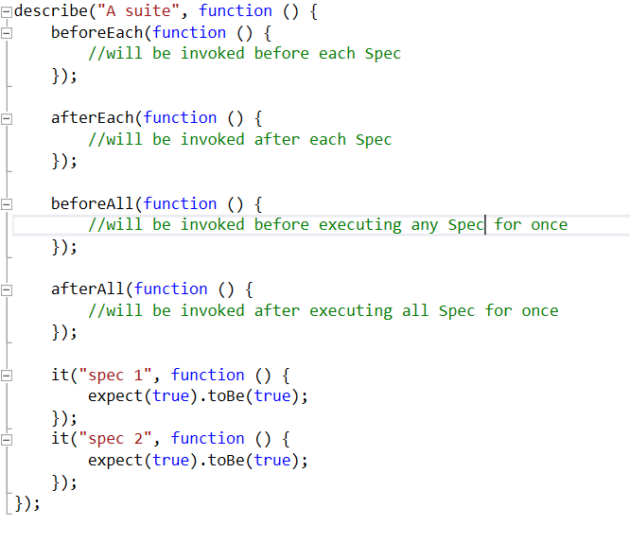
A more detailed structure

Slide 7
Matchers
toBe( 'expected' ) - exact compare (===)
toEqual( 'expected' ) - more general compare, can compare objects
toBeUndefined( ) - checks for undefined
toBeDefined( ) - checks if var is not undefined
toMatch( /regex/ ) - matches against regex
toBeNull( /regex/ ) - checks if a var is null
toBeTruthy( ) - checks if var is truthy
toBeFalsy( ) - checks if var is falsy
toBeLessThan( number ) - checks if value is less than number
toBeGreaterThan( number ) - checks if value is greater than number

Slide 8
toContain( item ) - look for item in array
expect( function(){ fn(); }).toThrow( e ) - fn() should throw an error
not - expect( 5 ).not.toEqual( 3 );

Slide 9
What is next?
Reveling module pattern - http://www.addyosmani.com/resources/essentialjsdesignpatterns/book/#revealingmodulepatternjavascript
Jasmine - http://jasmine.github.io/2.3/introduction.html
Pluralsight - http://www.pluralsight.com/courses/testing-javascript

